Slide 1
Predicates & Quantifiers
CSE-103: Discrete Mathematics
1

Slide 2
Predicate Logic
Predicate logic is an extension of propositional logic that permits concise reasoning about whole classes of entities.
E.g., “x>1”, “x+y=10”
Statements involving variables.
Such statements are neither true or false when the values of the variables are not specified.
2

Slide 3
Subjects and Predicates
The proposition
“x is greater than 3”
has two parts:
“the variable x” denotes the subject - the object or entity that the sentence is about.
“is greater than 3” denotes the predicate- a property that the subject can have.
3

Slide 4
Subjects and Predicates
Examples of Predicates
“x is greater than 3”
“x is greater than Y”
“x is greater than Y and Z”
“x can speak english”
p(x)=x is greater than 3
if x=2 then p(2)= 2 is greater than 3 —> F
Solved others example.
4

Slide 5
Propositional Functions
A predicate is modeled as a function P(x) from objects to propositions.
P denotes the predicate “is greater than 3”---refers to the property that the subject of the statement can have
Once a value has been assigned to the variable x, the statement P(x) becomes a proposition and has a truth value
e.g. if P(x) = “x > 1”, then P(3) is the proposition “3 is greater than 1.”
Note: The predicate P itself (e.g. P=“is sleeping”) is not a proposition (not a complete sentence).
5

Slide 6
Propositional Functions
EXAMPLE 1:
Let P(x) denote the statement “x > 3.” What are the truth values of P(4) and P(2)?
Solution: We obtain the statement P(4) by setting x = 4 in the statement “x > 3.” Hence,
P(4), which is the statement “4 > 3,” is true.
However,P(2), which is the statement “2 > 3,” is false.
6

Slide 7
Propositional Functions
EXAMPLE 2 :
Let Q(x, y) denote the statement “x = y + 3.” What are the truth values of the propositions Q(1, 2) and Q(3, 0)?
Solution: To obtain Q(1, 2), set x = 1 and y = 2 in the statement Q(x, y). Hence, Q(1, 2) is the statement “1 = 2 + 3,” which is false. The statement Q(3, 0) is the proposition “3 = 0 + 3,” which is true.
7

Slide 8
Propositional Functions
Predicate logic includes propositional functions of any number of arguments.
e.g. let P(x,y,z) = “x gave y the grade z”,
x=“Mike”, y=“Mary”, z=“A”,
P(x,y,z) = “Mike gave Mary the grade A.”
Example: Let R(x, y, z) denotes the statement x + y = z. What would be the truth values of the propositions R(1, 2, 3) and R(0, 0, 1)?
Solution: For R(1, 2, 3) the statement would be 1 + 2 =3; which is true; where x =1, y=2 and z=3.
For R(0, 0, 1) the statement would be 0 + 0 =1; which is false; where x =0, y=0 and z=1.
8

Slide 9
Quantifiers
Another way of creating proposition from propositional function-----Quantification.
Two types of quantification is discussed:
Universal Quantification
Existential Quantification
Quantification expresses the extent to which a predicate is true over a range of elements.
9

Slide 10
Universe of Discourse
A property is true for all values of a variable in a particular domain called universe of discourse.
The collection of values that a variable x can take is called x’s universe of discourse.
e.g., let P(x)=“x+1>x”.
We could define the course of universe as the set of integers.
10

Slide 11
Universal Quantification
Definition 1: The universal quantification of P(x) is the proposition “P(x) is true for all values of x in the universe of discourse.”
The notation “∀ x P(x)” denotes the universal quantification of x, where ∀ is universal quantifier, and proposition ∀ x P(x) expressed as:
“for all P(x)” or “for every P(x)”
for all x in the u.d., P holds.
Example: Let P(x) is “x + 1 > x”. What would be the truth value of ∀ x P(x) if u. d. is the set of all real numbers?
Solution: Since P(x) is true for all real number , the quantification ∀ x P(x) is true.
11

Slide 12
Universal Quantification
EXAMPLE: Let Q(x) be the statement “x < 2.” What is the truth value of the quantification ∀xQ(x), where,the domain consists of all real numbers?
Solution: Q(x) is not true for every real number x, because, for instance, Q(3) is false. That is, x = 3 is a counterexample for the statement ∀xQ(x). Thus,∀xQ(x) is false.
12

Slide 13
Existential Quantification
Definition 2: The existential quantification of P(x) is the proposition “There exists an element x in the universe of discourse such that P(x) is true.”
The notation “∃ x P(x)” for the existential quantification of P(x), where ∃ is existential quantifier, and proposition ∃ x P(x) expressed as:
“There is an x such that P(x)” or “There is at least one x such that P(x)”
for some x in the u.d., P holds.
Example: What is the truth value of ∃ x P(x) where P(x) is the statements “x ² > 10 ” and the u. d. consists of the positive integers not exceeding 4?
Solution: Since u.d. is {1, 2, 3, 4}, then the proposition ∃ x P(x) is the disjunction: P(1)∨P(2) ∨P(3) ∨P(4). Since P(4) is the statement “4² > 10” is true as a result ∃ x P(x) is true.
13

Slide 14
Existential Quantification
EXAMPLE 13 Let P(x) denote the statement “x > 3.” What is the truth value of the quantification ∃xP(x),where the domain consists of all real numbers?
Solution: Because “x > 3” is sometimes true—for instance, when x = 4—the existential quantification of P(x), which is ∃xP(x), is true. ◂
Observe that the statement ∃xP(x) is false if and only if there is no element x in the domainfor which P(x) is true. That is, ∃xP(x) is false if and only if P(x) is false for every element of the domain.
14

Slide 15
Quantifier Equivalence Laws
Definitions of quantifiers: If u.d.=a,b,c,… ∀x P(x) ⇔ P(a) ∧ P(b) ∧ P(c) ∧ …
which means conjunctions among values. ∃x P(x) ⇔ P(a) ∨ P(b) ∨ P(c) ∨ …
which means disjunctions among values.
Table 1: Quantifiers
Statements | When true? | When false?
∀x P(x) | P(x) is true for every x. | There is an x for which P(x) is false.
∃x P(x) | There is an x for which P(x) is true. | P(x) is false for every x.
15

Slide 16
Quantifier of two variables
Example: Let Q(x, y, z) be the statement “x + y =z”. What are the truth values of ∀x ∀y ∃z Q(x, y, z) and ∃z ∀x ∀y Q(x, y, z)?
Solution: Suppose x and y are assigned values and z is real number such that x + y =z.
Then the quantification ∀x ∀y ∃z Q(x, y, z) is the statement
“For all real number x and for all real number y there is a real number z such that x + y = z” is true. The order of quantifier is important here.
Now the quantification ∃z ∀x ∀y Q(x, y, z) is the statement
“ There is a real number z that for all real number x and for all real number y is true that x + y = z” which is false, since there is no value of z for all values of x and y that satisfy “x + y = z”.
16

Slide 17
Quantifier of two variables
Table 2: Quantifier of two variables
Statements | When true? | When false?
∀x ∀y P(x, y) ∀y ∀x P(x, y) | P(x, y) is true for every pair of x, y. | There is a pair x, y for which P(x, y) is false.
∀x ∃y P(x, y) | For every x there is a y for which P(x, y) is true. | There is an x such that P(x, y) is false for every y.
∃x ∀y P(x, y) | There is an x such that P(x, y) is true for every y. | For every x there is a y for which P(x, y) is false.
∃x ∃y P(x, y) ∃y ∃x P(x, y) | There is a pair x, y for which P(x,y) is true. | P(x,y) is false for every pair x, y.
17

Slide 18
Negation
Often negation of a statement is required. Consider the following statement:
“Every student in your class has taken a course in calculus” ……….negation???
“It is not the case that every student in your class has taken a course in calculus” can be express as:
∃x ┐P(x)
We can use the following equivalence:
┐∀x P(x) ⇔ Ex ┐P(x)
18

Slide 19
More Equivalence Laws
¬∃x P(x) ⇔ ∀x ¬ P(x) ¬∀x P(x) ⇔ ∃x ¬ P(x)
∀x ∀y P(x,y) ⇔ ∀y ∀x P(x,y) ∃x ∃y P(x,y) ⇔ ∃y ∃x P(x,y)
∀x (P(x) ∧ Q(x)) ⇔ (∀x P(x)) ∧ (∀x Q(x)) ∃x (P(x) ∨ Q(x)) ⇔ (∃x P(x)) ∨ (∃x Q(x))
19

Slide 20
Scope of Quantifiers
The part of a logical expression to which a quantifier is applied is called the scope of this quantifier.
e.g., (∀x P(x)) ∧ (∃y Q(y))
e.g., (∀x P(x)) ∧ (∃x Q(x))
20

Slide 21
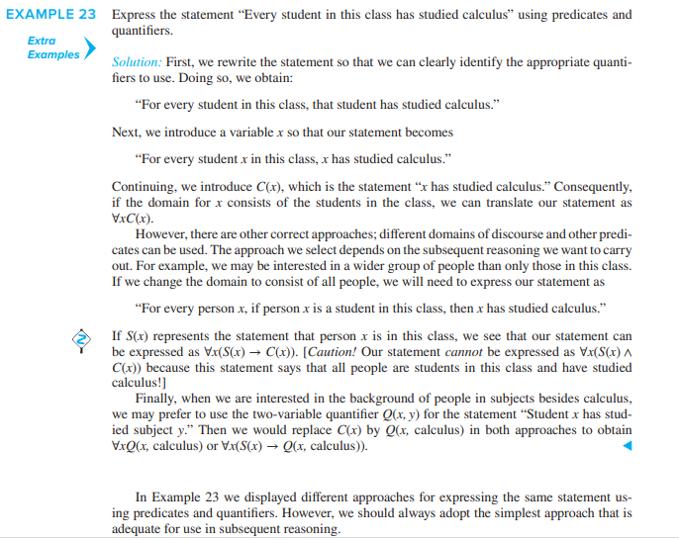
Translating from English into Logical Expressions
21

Slide 22
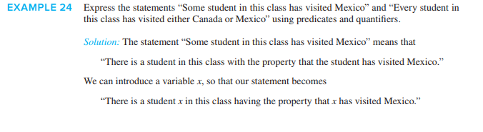
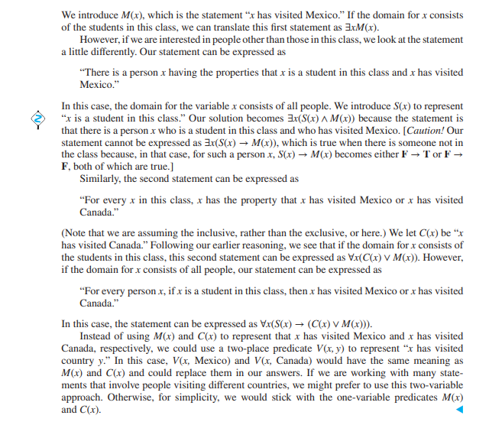
22

Slide 23
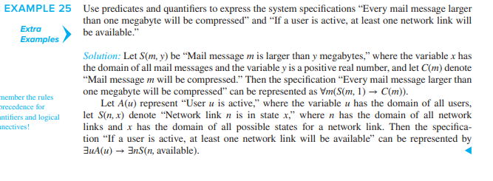
Using Quantifiers in System Specifications
23

Slide 24
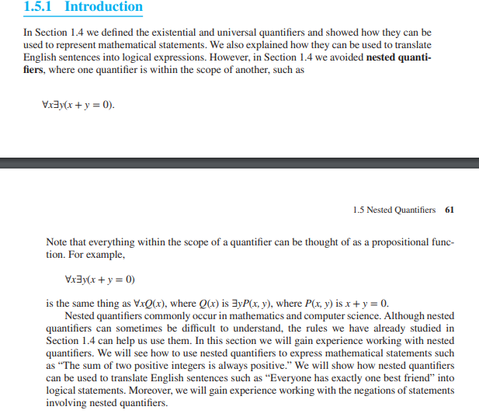
Nested Quantifiers
24

Slide 25
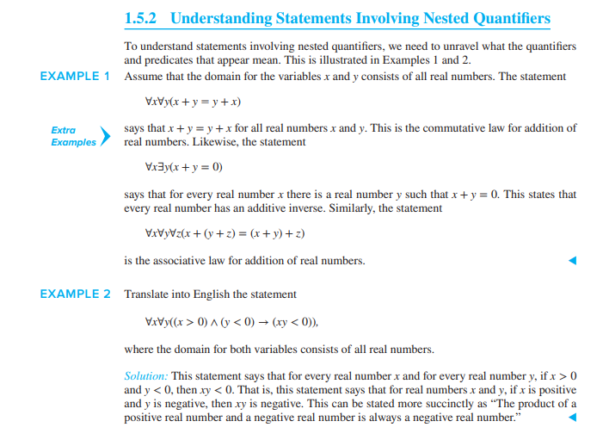
Nested Quantifiers
25

Slide 26
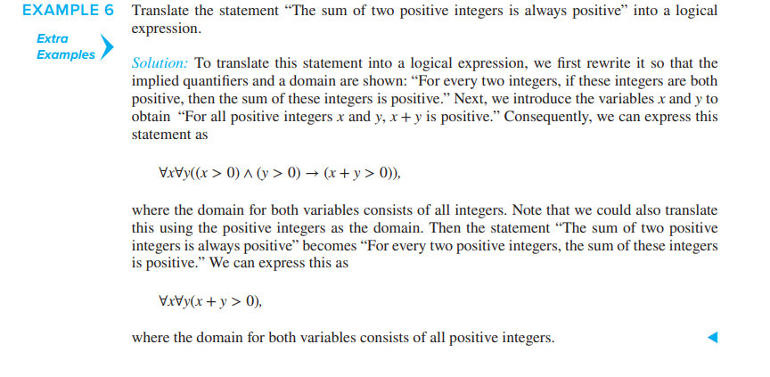
Nested Quantifiers
26

Slide 27
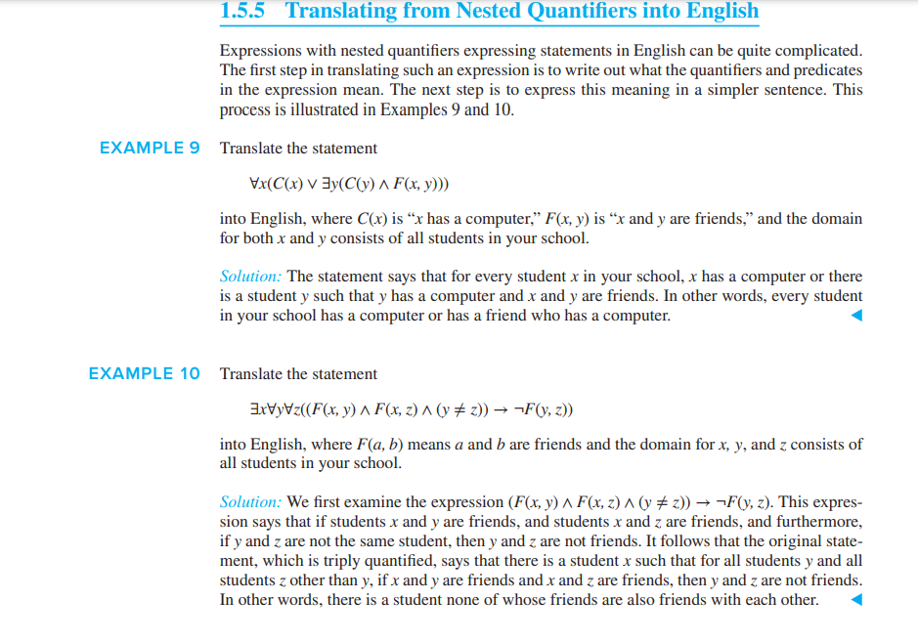
27

Slide 28
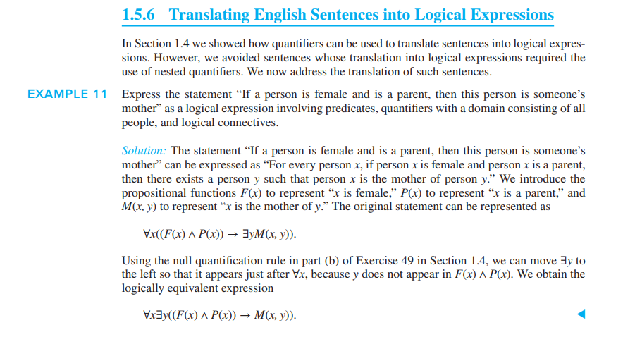
28

Slide 29
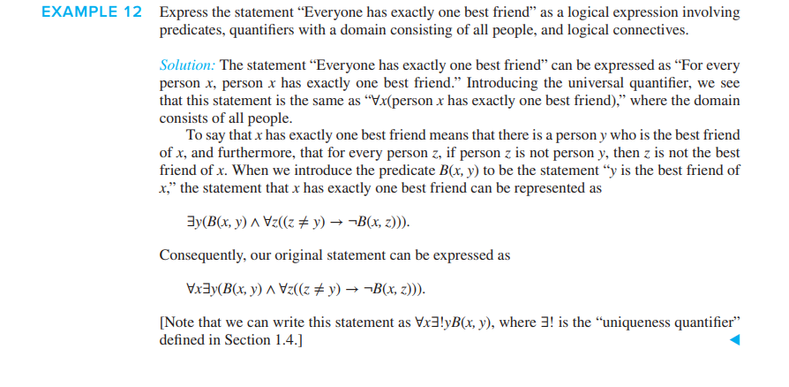
29

Slide 30
Solution from Exercise
Problem: Let P(x) is “x can speak Russian” and Q(x) is “x knows the computer language C++ ”. Universe of discourse is all students of your class.
“There is a student at your class who can speak Russian and who knows C++” can be expressed as ∃x (P(x) Ʌ Q(x))
“There is a student at your class who can speak Russian but who doesn’t knows C++” can be expressed as ∃x (P(x) Ʌ ┐Q(x))
“Every student at your class either can speak Russian or knows C++” can be expressed as ∀x (P(x) V Q(x))
“No student at your class can speak Russian or knows C++” can be expressed as ∀x ┐(P(x) Ʌ Q(x))
30

Slide 31
Solution from Exercise
Problem: Suppose the universe of discourse of the propositional function P(x, y) consists of pairs x and y where x and y can be 1, 2 or 3. Write out the following propositions using disjunctions and conjunctions.
∃x P(x, 3) ⇔ P(1, 3)V P(2, 3)V P(3, 3)
∀y P(1, y) ⇔ P(1, 1) Ʌ P(1, 2) Ʌ P(1, 3)
∀x ∀y P(x, y) ⇔ P(1,1) Ʌ P(1,2) Ʌ P(1,3) Ʌ P(2,1) Ʌ P(2,2) Ʌ P(2,3) Ʌ P(3,1) Ʌ P(3,2) Ʌ P(3,3)
∃x ∃y P(x, y) ⇔ P(1,1) V P(1,2) V P(1,3) V P(2,1) V P(2,2) V P(2,3) V P(3,1) V P(3,2) V P(3,3)
∃x ∀y P(x, y) ⇔ (P(1,1) Ʌ P(1,2) Ʌ P(1,3)) V (P(2,1) Ʌ P(2,2) Ʌ P(2,3)) V (P(3,1) Ʌ P(3,2) Ʌ P(3,3))
∀y ∃x P(x, y) ⇔ (P(1,1) V P(2,1) Ʌ P(3,1)) Ʌ (P(1,2) V P(2,2) V P(3,2)) Ʌ (P(1, 3) V P(2, 3) V P(3,3))
31

Slide 32
Solution from Exercise
Problem: Determine the truth value of the following statements if the universe of discourse for all variables is the set of all integers.
∀n (n² ≥ 0) is true.
∀n ∃m (n² < m) is true.
∃n ∃m (n + m =4 Ʌ n – m = 1) is false.
∀n ∀m ∃p (p = (m+n)/2) is false.
32

Slide 33
Thank You
Study all the solved problem from your text book.
Try to solve related problems from exercise.
33

